Slide 1






OSCaR
Case Management and M&E

Slide 2
2015-2019
From Children in Families -
to FCF|REACT -
to the wider sector…

Slide 3

Problem(s)
Initially CIF’s problems, but pretty general too.
Limited number of trained social workers in the workforce.
Very few commonly used frameworks or tools.
Almost nothing in Khmer.

Slide 4
Objectives
Provide a high quality case-management toolset
Increase organizational access to practice and outcome data
Do that in English and Khmer

Slide 5
Objectives
Provide a high quality case-management toolset
Increase organizational access to practice and outcome data
Do that in English and Khmer
AND
Make all that available and customizable to the wider social services community.

Slide 6
OSCaR Structure
A core case-management focused toolset.
Supporting customizable form-sets, for accurately reflecting service delivery and programming needs at each organisation.
A robust report-builder for interrogating the data prior to exporting it for further analysis.

Slide 7
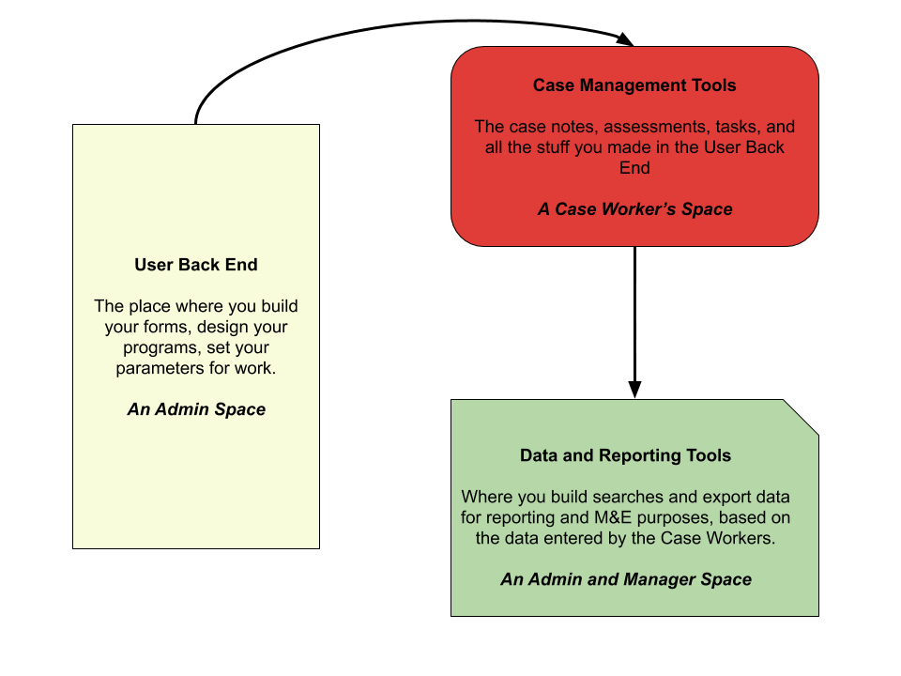
OSCaR Structure

Slide 8
Setup and Customization Tools
Form Builder.
Custom Program Stream builder.
Support from the OSCaR team in the setup phase.

Slide 9
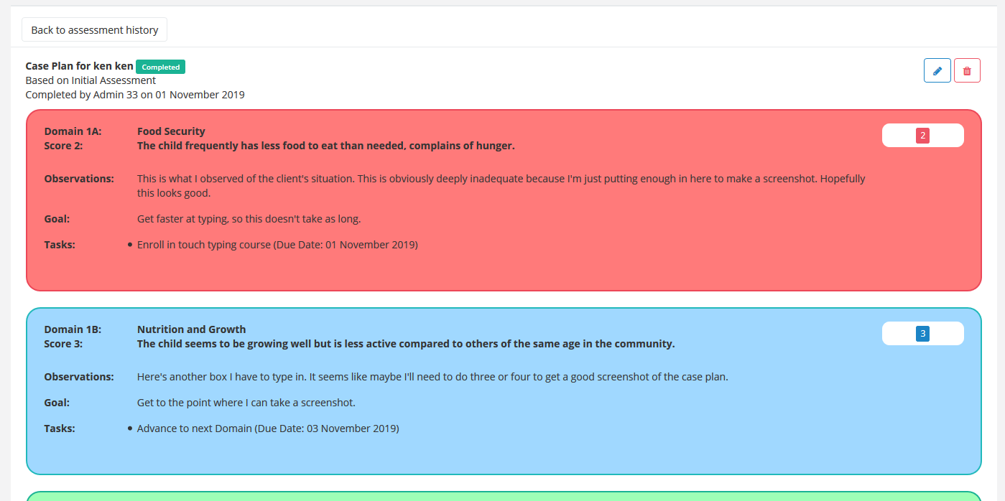
Case Management Tools
Notes:
Child Status Index (CSI) as the central assessment tool.
Custom OSCaR deployment of the CSI to link with goal setting and task management.
Automatically generated client Case Plan.

Slide 10
Case Management Tools
Integration of Case Plan goals, case notes, and task management.
Task notifications, timed for the worker’s role.

Slide 11
Case Management Tools
Supporting forms and “Custom Program Streams”
Customizable Assessments
Allows for accurate monitoring of numbers of supported beneficiaries.
Custom tools can effectively replace the existing toolset if necessary.

Slide 12
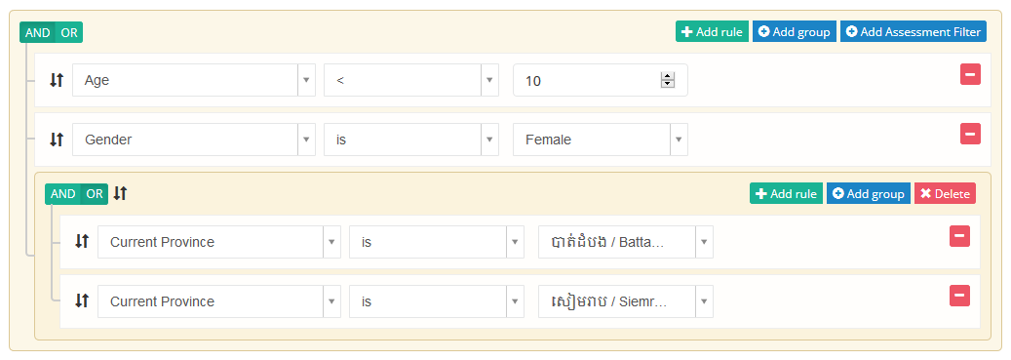
M&E and Reporting Tools
Notes:
Report builder which can access and filter by all fields, including custom ones.
Groupable and stackable AND/OR filters for query building.
Savable searches.
WYSIWYG XLS file export.
Specific export function for Assessment scores.

Slide 13
Target Users
Social Work program staff:
working in NGOs or other organisations, supporting children and other vulnerable groups.
Organization management staff:
working with government offices and donors, to help them understand the work of their organization.

Slide 14
Sector Integration
Organizational Service Integration:
Foundational, but complex.
Helping organizations think about how they measure their work.
Balancing M&E needs against the realities of case management work flow. “What will workers actually do?”

Slide 15
Sector Integration
Cooperation with UNICEF and Primero
Cambodian Government working with Primero to develop a case management system for MOSVY and its offices.
OSCaR continuing to provide substantial NGO support, and developing an interoperability framework with Primero.

Slide 16
Sector Integration
OSCaR Anti-Trafficking
Working with an anti-trafficking NGO in Phnom Penh to develop a version of OSCaR for the Anti-Trafficking Sector.
Different assessment framework.
Including integration of MOSVY form-sets in this product.

Slide 17
Achievements to Date
35 User Organisations in 4 countries.
Over 11,000 client records in the database.
Continued USAID, UNICEF and Save the Children Funding through 8 successful funding applications.
Featured in USAID Bright-Spot Analysis

Slide 18
Lessons Learned
Consultation
Nice to learn from a success!
Find out what people want, and ensure they feel listened to.
Do not let them dictate development.

Slide 19
Lessons Learned
Documentation
Rolling out a system in active development makes this complex.
Huge drain on human resources, managing tech queries.
A source of frustration to users.

Slide 20
Thank You

